Slide 1






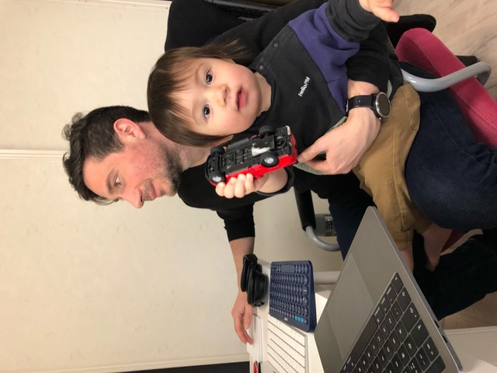
Understanding attitudes, experience and risk factors for domestic violence
International Team of Scientists working at JAMSTEC, Japan
Prima Anugerahanti
Indonesia
Gerlien Verhaegen
Belgium
Heather Ritchie
Scotland
Arthur Bauville
France
Ettore Barbieri
Italy

Slide 2

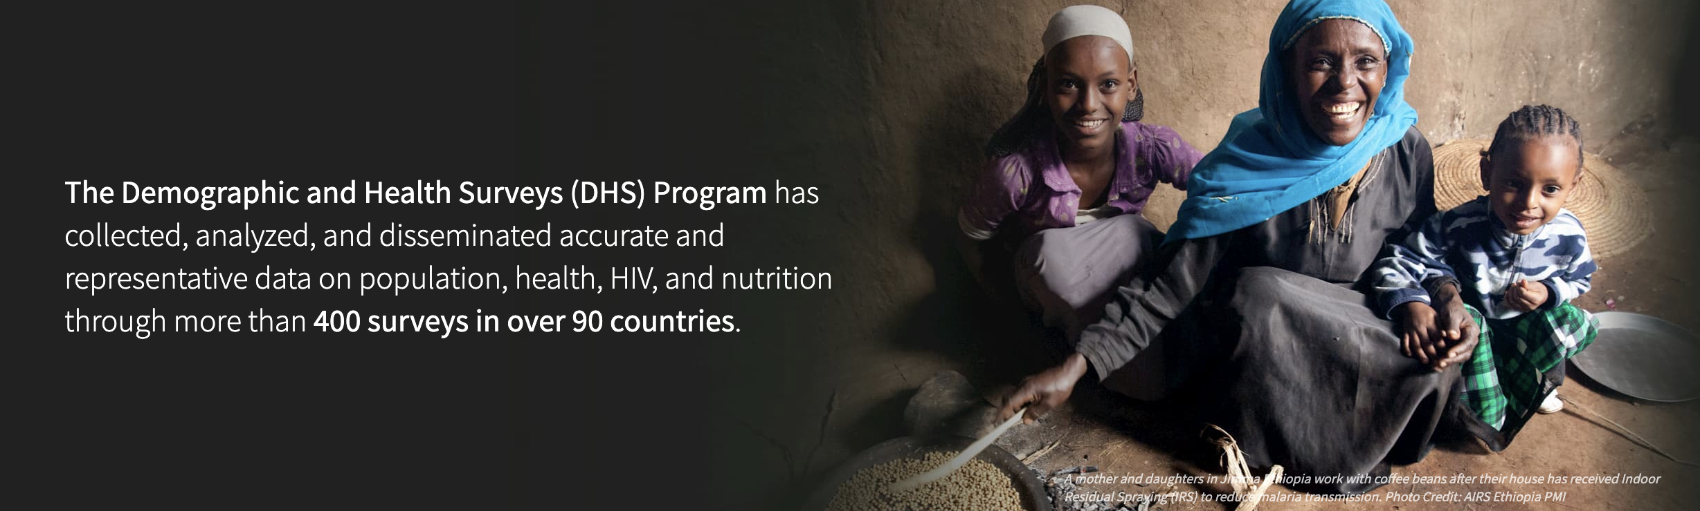
Using data provided by the DHS Program we wanted to:
Investigate the acceptance vs the experience of domestic violence
Determine the controlling factors of domestic violence
Develop a tool that would quickly and efficiently identify women who are at risk of domestic violence

Slide 3
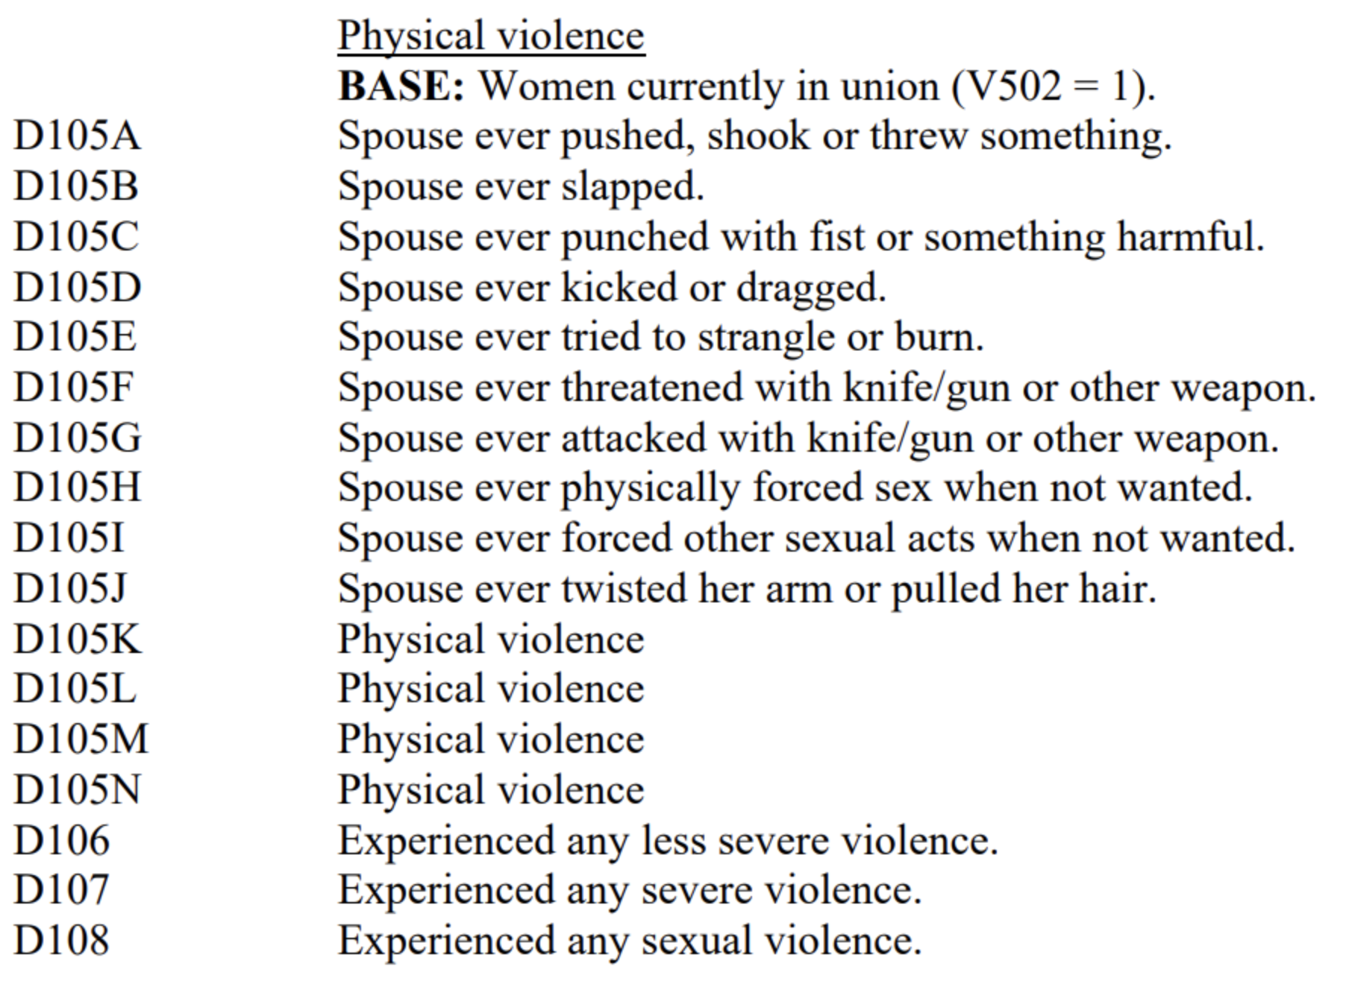
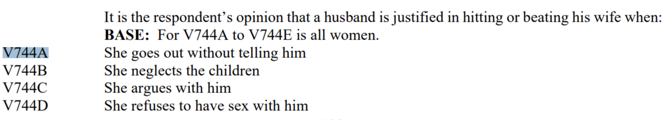
DHS Program data for acceptance and experience of domestic violence
Acceptance: % of yes to at least one answer of:
Experience: % of yes to at least one answer of:

Slide 4
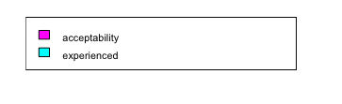
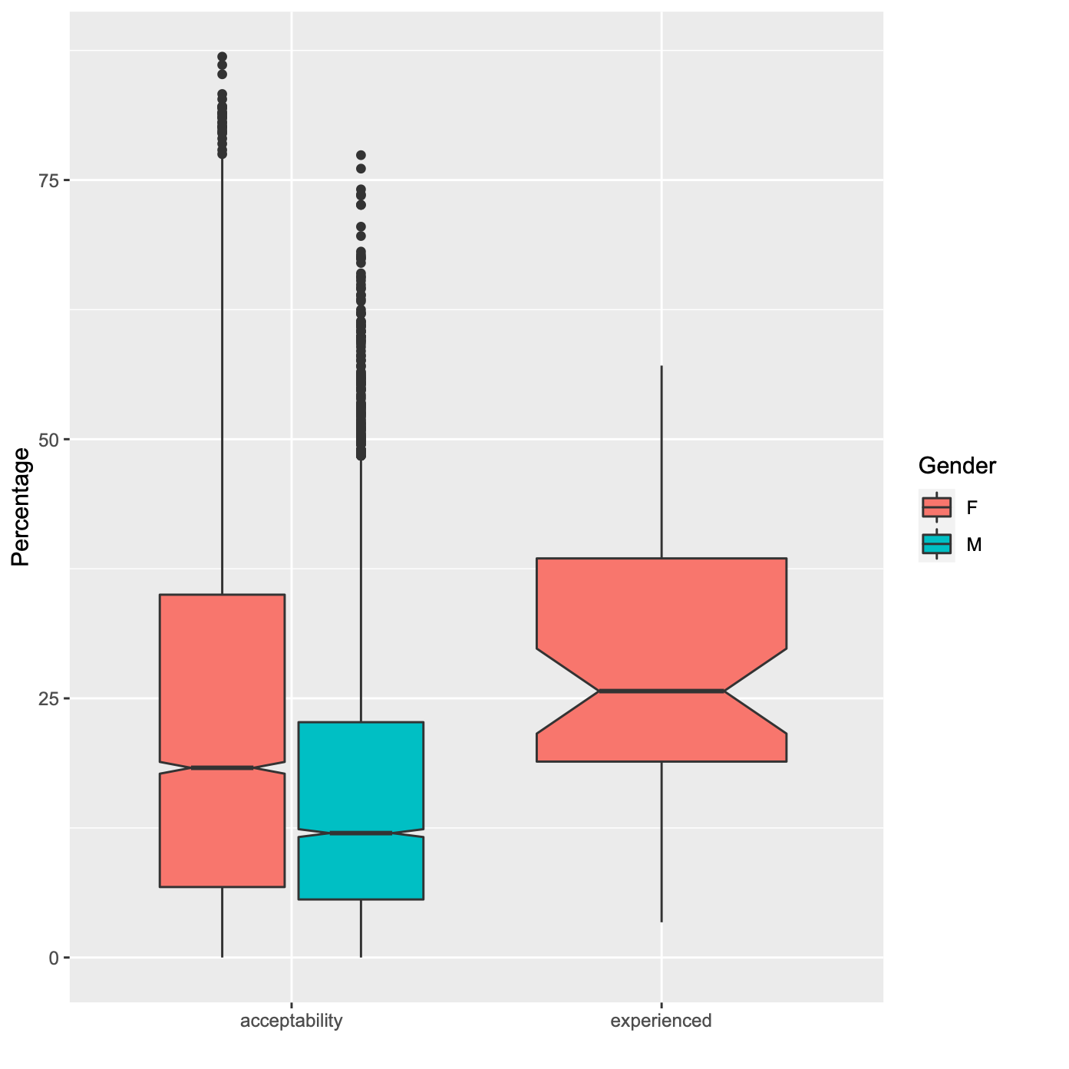
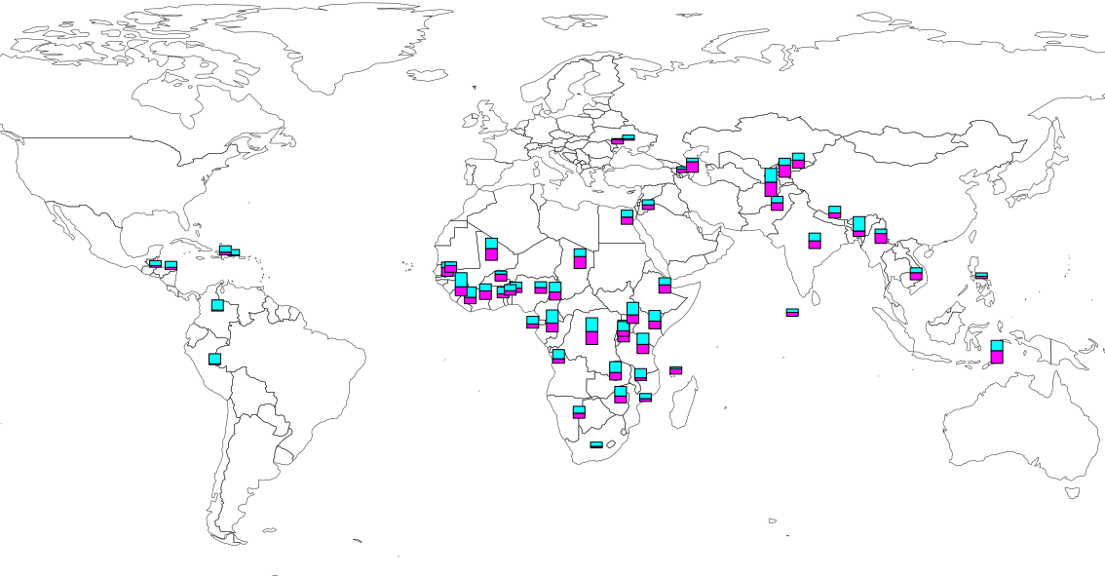
Acceptance vs experience of domestic violence
Acceptance
Experience
Domestic violence is widespread amongst the countries surveyed by the DHS
On average across all countries 26% of women surveyed have experienced physical and/or sexual domestic violence
Overall more women than men agreed that domestic violence was acceptable in certain circumstance

Slide 5
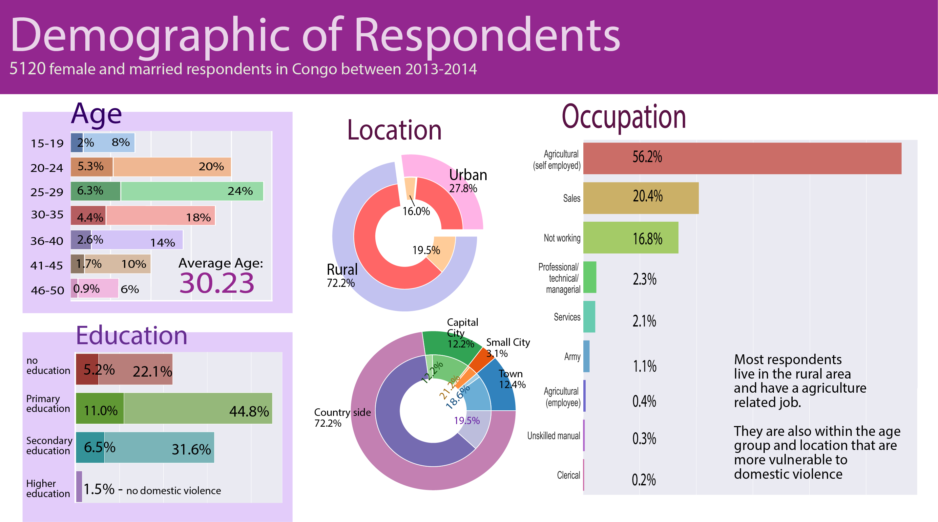

Slide 6
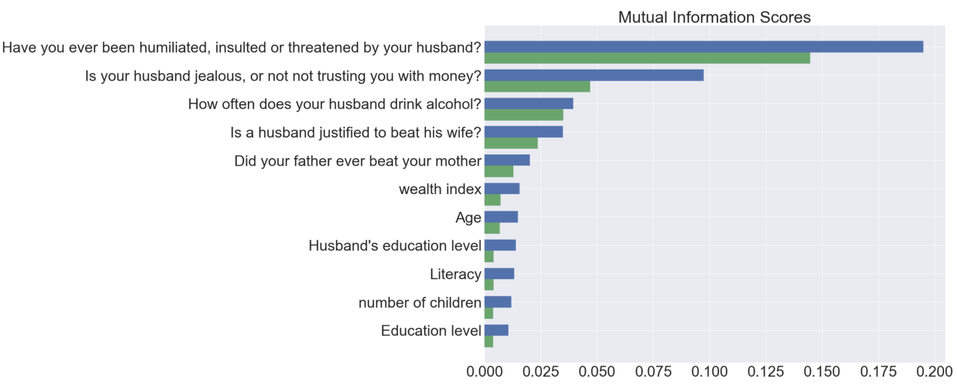
From which information can we predict answers to the question:
“Have you experienced physical or domestic violence in the last 12 months?”
Benin
Emotional violence:
Control issues:
Congo
Alcohol consumption:
Acceptance of violence:
Family history:
Demographics:

Slide 7
In Benin it seems that emotional violence occurs before physical violence and therefore we may be able to identify women at risk
In Congo
Is emotional violence predictive of physical/sexual violence
Benin
Congo
A
B
Physical Violence 4.52%
Emotional Violence 9.94%
Physical Violence 18.52%
Emotional Violence
14.02%
(Benin) 63%
(Congo) 51%
$$P(B|A)$$
of women experiencing physical violence also experience emotional violence
(Benin) 29%
(Congo) 67%
$$P(A|B)$$
of women experiencing emotional violence also experience physical violence
In both countries emotional and physical violence are correlated but emotional violence seems to be a precursor of physical/sexual violence only in Benin

Slide 8
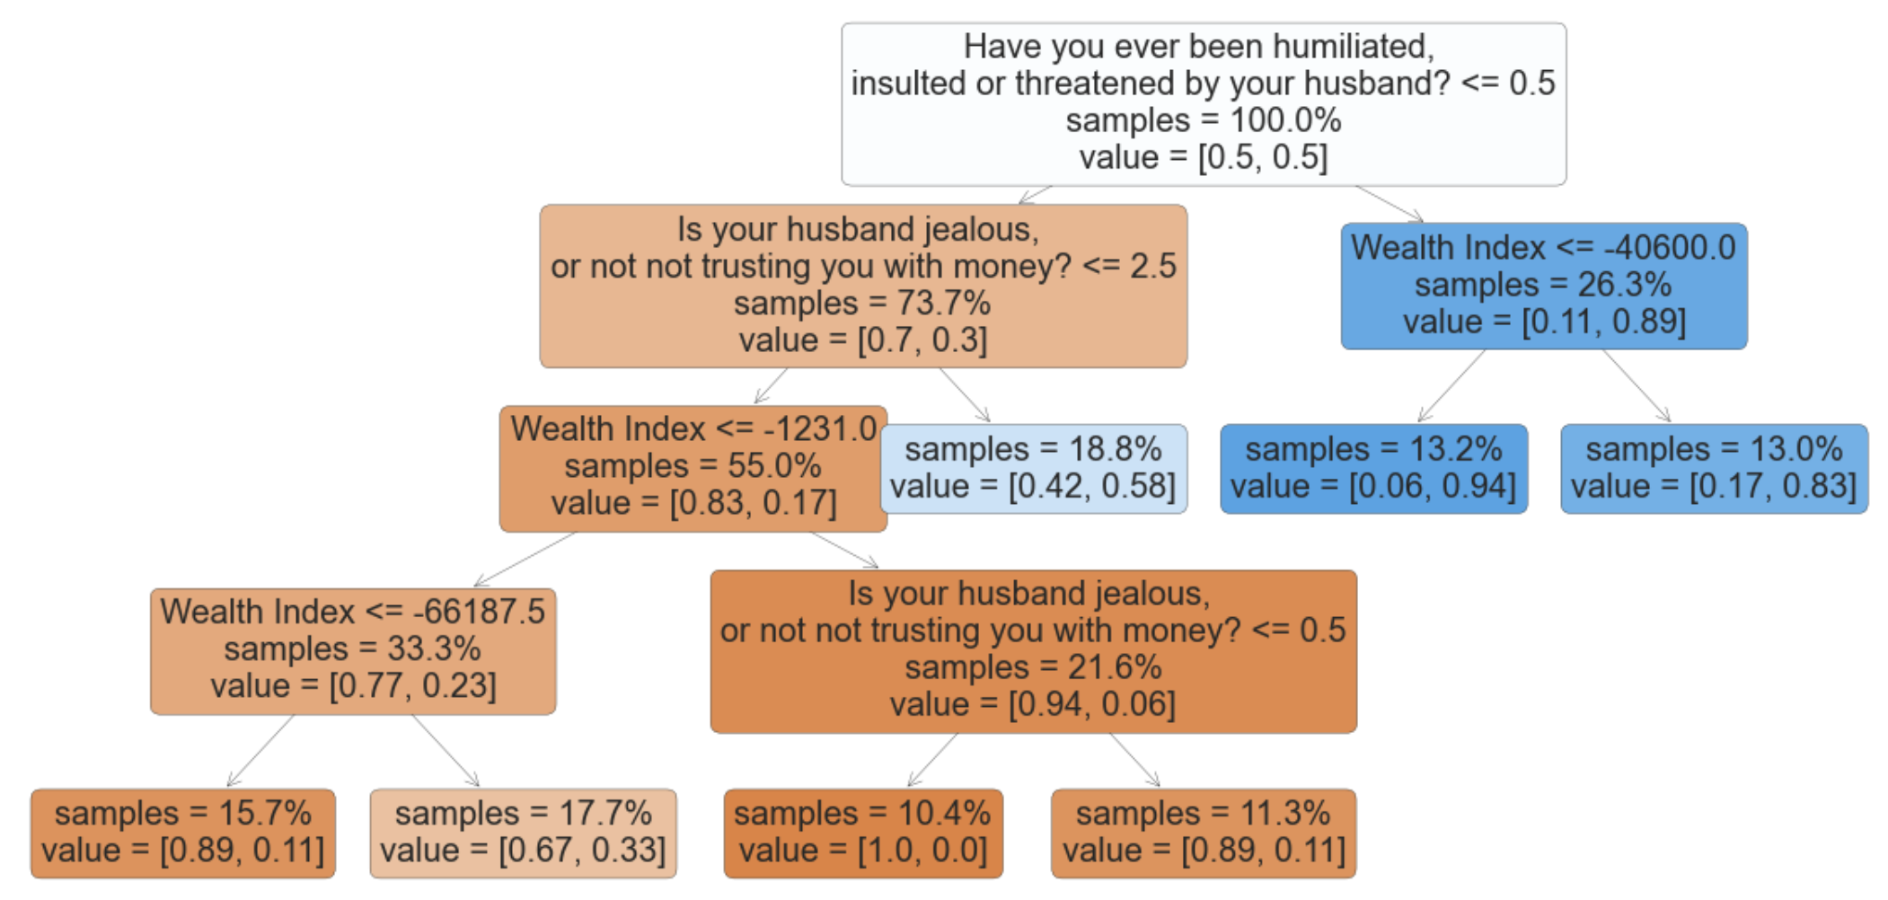
How well can we identify women at risk of physical violence?
Binary classification tree: doesn’t require a computer (paper, dialogue)
True: this woman is experiencing violence
Sincet he dataset is initially imbalanced we subsampled the majority class to reach 50% False, 50% True
Hyperparameters were tuned to optimize recall because:
True positives are women in danger (experiencing physical or sexual violence)
False negatives are women in danger but not detected (should be minimized)
False positives are women who are not experiencing physical violence but may in the future
$$recall=\frac{truepositives}{truepositives+falsenegatives}$$
Women in danger:
redirect to a specialist
The model can be used to:
design a personalized questionnaire
quantitavely interpret the results of a general questionnaire
Raise awareness in the general public

Slide 10
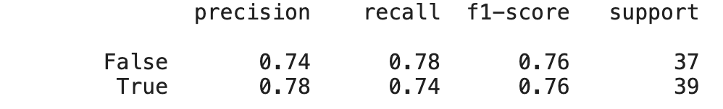
How well can we identify women at risk of physical violence?
Binary classification tree: doesn’t require a computer (paper, dialogue)
True: this woman is experiencing violence
Sincet he dataset is initially imbalanced we subsampled the majority class to reach 50% False, 50% True
Hyperparameters were tuned to optimize recall because:
True positives are women in danger (experiencing physical or sexual violence)
False negatives are women in danger but not detected (should be minimized)
False positives are women who are not experiencing physical violence but may in the future
$$recall=\frac{truepositives}{truepositives+falsenegatives}$$
Women in danger:
redirect to a specialist
Model’s performance
The model can be used to:
design a personalized questionnaire
quantitavely interpret the results of a general questionnaire
Raise awareness in the general public
Predicted label
False
True
Metrics
False
38%
10%
Actual
True
13%
38%

Slide 11
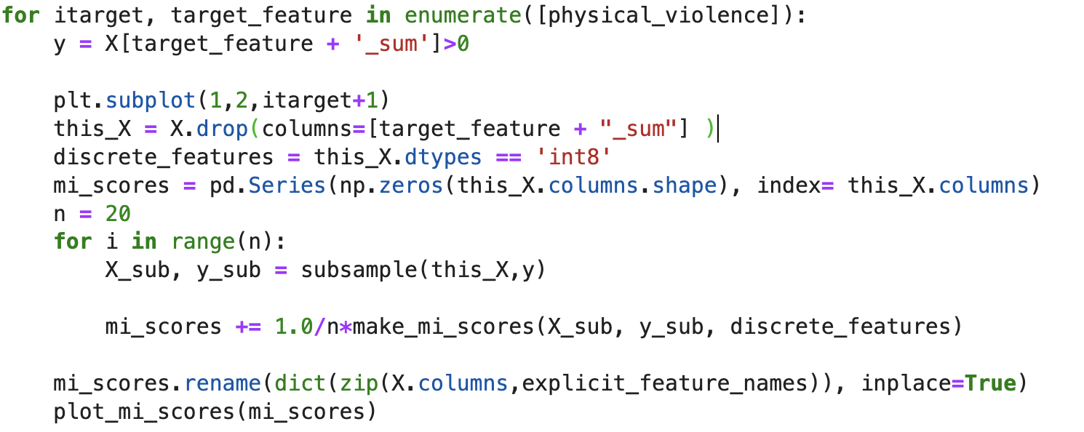

Slide 12
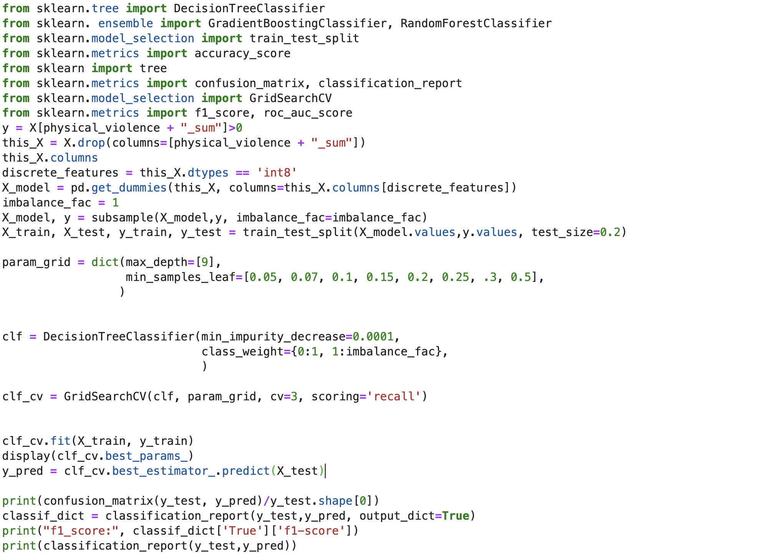
Model code

Slide 13



Can we use these data to predict which women are at most risk of future violence?

Slide 14

Code
dat <- read.csv("acceptability_vs_experienced_vs_gender.csv")
library(ggplot2)
ggplot(dat, aes(x = Category, y = Value))+
geom_boxplot(aes(fill = Gender),notch=TRUE,las=2)+
labs(y="Percentage", x="")

Slide 15
Code
library(rworldmap)
mapBars( dat,nameX="lon", nameY="lat",
nameZs=c('acceptability','experienced'),barWidth = 3,
borderCol= "grey17", zColours = c("magenta","cyan"))

